Slide 1
Organic food versus conventional food

Slide 2
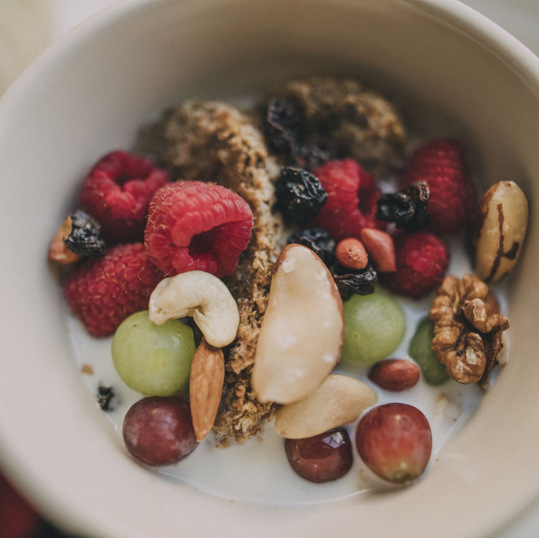
What is organic food?
Organic food is food which is grown without chemicals and genetically modified products. Organic food is defined by a law from the EU.

Slide 3
Pros & Cons of organic food
Pros
Cons
with organic food you have the full taste experience
You have animal welfare
Less soil pollution
Less need for antibiotics
Positive human health effects
Avoidance of hormonal treatments
Higher food quality
Higher food prices
Limited choice of products
Shorter shelf life/ is quite limited
Quality of organic food greatly varies across producers
Health risks if production chain is not optimized

Slide 4
What is the effect for the economy?
Organic products often cost more than their conventional counterparts and grocery stores and local farmers market
But does that mean that organic agriculture overall ?
The answers that experts have found , though the issue is multifaced and complex are suprisingly consistent:
For most people, organic agriculture appears to be more effecient economic system, both for the generating profit and reducing the sort of environmental impacts ( often thought of as ´´Hidden costs´´ ) that end up costing consumers in other ways. Hence, Organic is more profitable than conventional farming.

Slide 5
Why does it cost more ?
Production costs for organic food are typically higher because of greater labor input; which also means they have more living space and are not geneticly engineered
Ogranic food supplies are limited
Farmers dont produce enough o a singlr product to lower the overall costs

Slide 6
The difference between organic labels
If labels say…
… ´´organic´´ it obviously has to contain 95 % of organic ingredients
… ´´made with organic ingredients´´ up to 70% of the total ingredients may be organic
... ´´containing organic ingredients´´ it mostly contains 50 % organic components
… ´´100% organic´´ it truly contains 100% organic ingredients

Slide 7
Organic labels in Germnay
If you see a label with ´´BIO´´ in Germany, you can be sure that animals are only being fed with organic feed and the use of antibiotics is very limited with the Germany organic Seal, which has existed since 2011, identifies food from controlled organic cultivation. The Criteras are based on provisions of the EU organic Regulation.

Slide 8
Difference between normal and organic Milk
Normal Milk
Organic Milk
Cows that produce normal milk tend to have smaller cages
They also get milked more often
Their feed also contains genetic enigeenering
Could contain residue anibiotics
they grow up without grow up hormons
The cows must live in a space of 10qm per cow
They get milked less; that means they only get milked 2 times per day and not 3 times
They strictly get natural straw; which means without antibiotics

Slide 9
Thanks for watching !!!

Slide 10
Sources
www.enviornmentalconscience.com
www.wikipedia.com
www.ökolandbau.de
www.greenlifestyle.de
www.bioland.de

